Slide 1
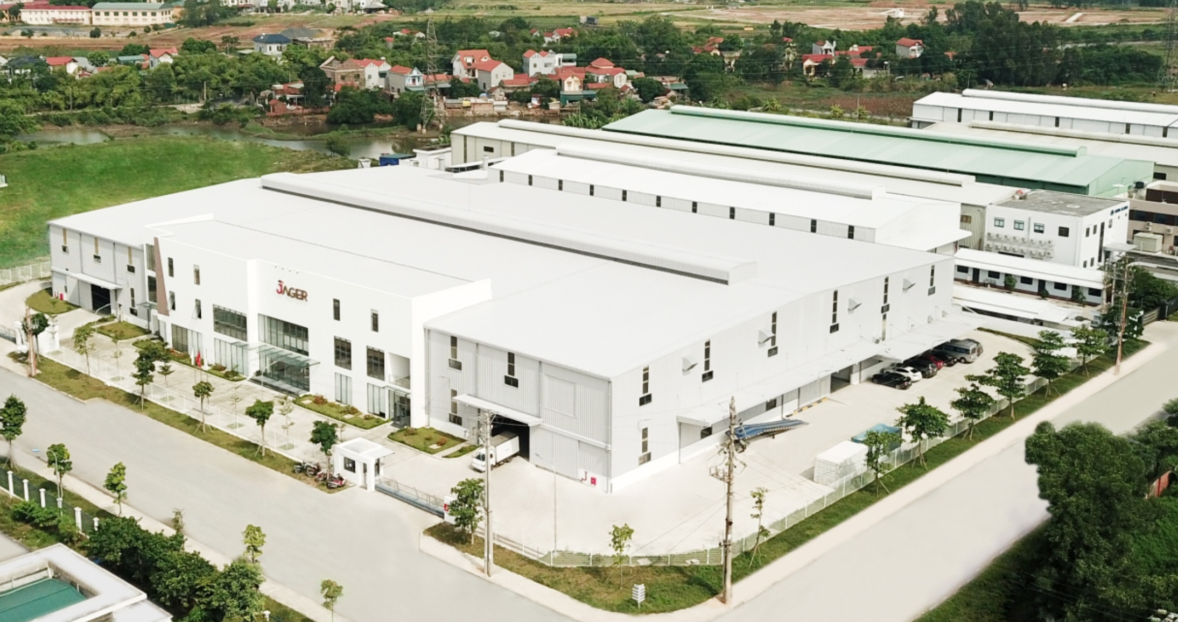

Slide 2
Who are we?
We are a group of people who have desire to bring beauty and perfection.
We are people who creating dreams of a high-class living space and high living quality for the community.
We are the factory producing high quality furniture, starting an ecosystem of modern and distinctive industrial furniture, with the goal of leading in the domestic furniture market and exporting to the world.
We are known for the brand: JAGER FURNITURE MANUFACTURER
What do we do?
With the JAGER brand, we provide high quality furniture products to investors who are large real estate corporations, designers and individual customers.
Furthermore, also at JAGER, we eliminate the complexity of normal furniture retail, using technology to keep direct customer communication to a minimum but still highly effective. All customers can control their creation, design and production of their space as much as possible without spending too much time meeting and exchanging directly. Minimizing intermediate time, increasing work efficiency.
Jager has entered many markets in the world such as: US, Canada, Japan ... This is the good assessment of our production quality. Our products satisfy our customers even in the most demanding markets of the world.
GREETINGS

Slide 3
HISTORY OF DEVELOPMENT
16-10-2019
Commencement of the construction site
04-2020
Jager high-class furniture factory completed after 6 month of the construction, went into operation with a total capacity of 400,000 product a years
06-2020
Export the first order to Japan
2020-2021
Journey to the future: Building and Developing the market

Slide 4
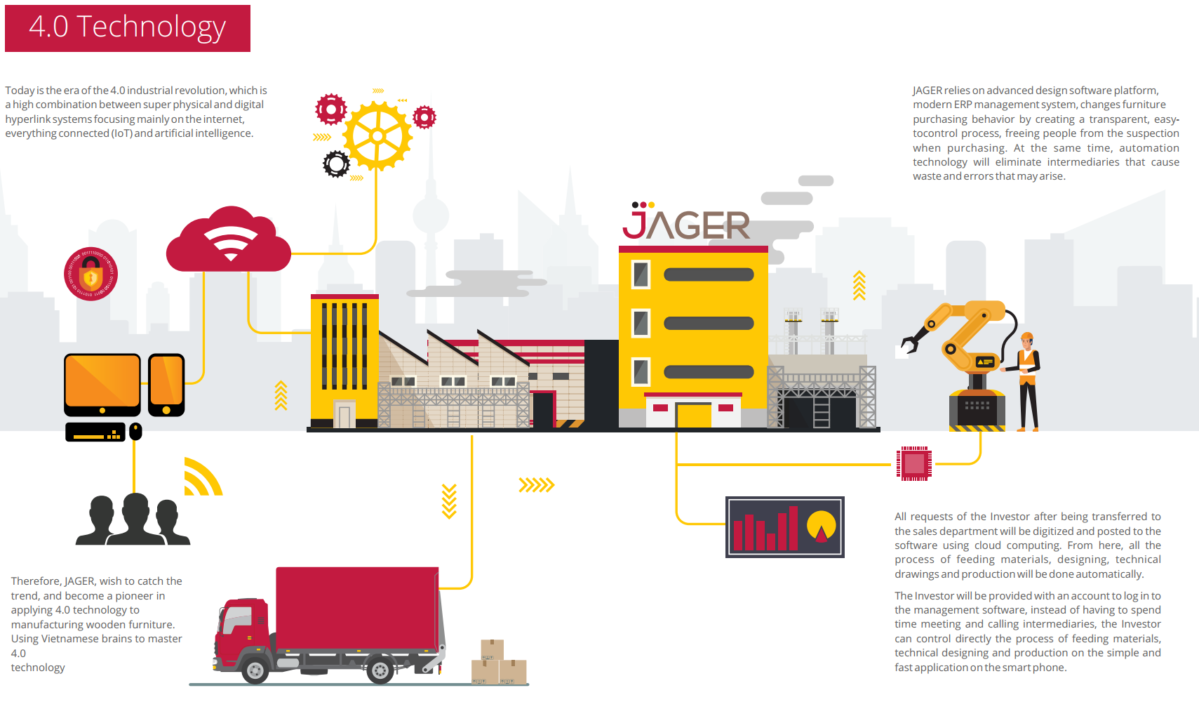

Slide 5
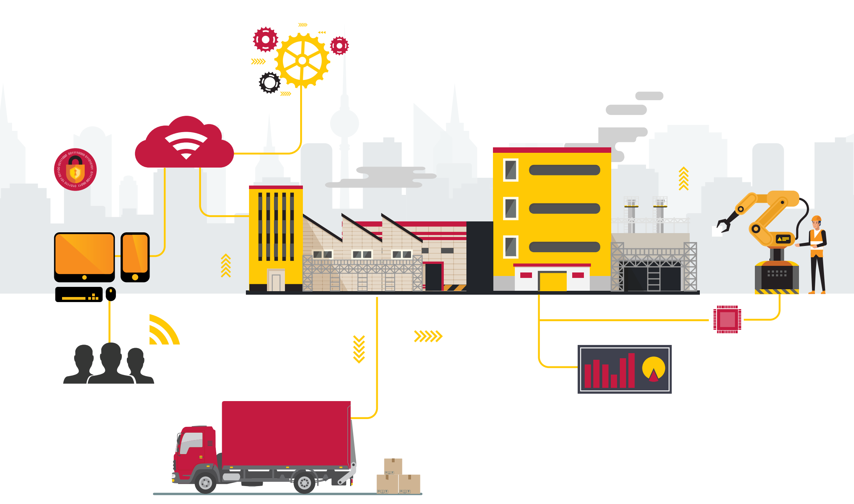
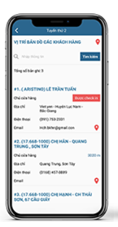
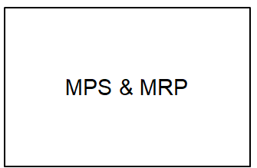
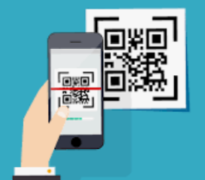
SMART FACTORY
Integration
Smart warehouse
Integration Production Line by IIOT
Using barcode, QRCode
Integration
3S PLM
SCM
FI & CO

Slide 6
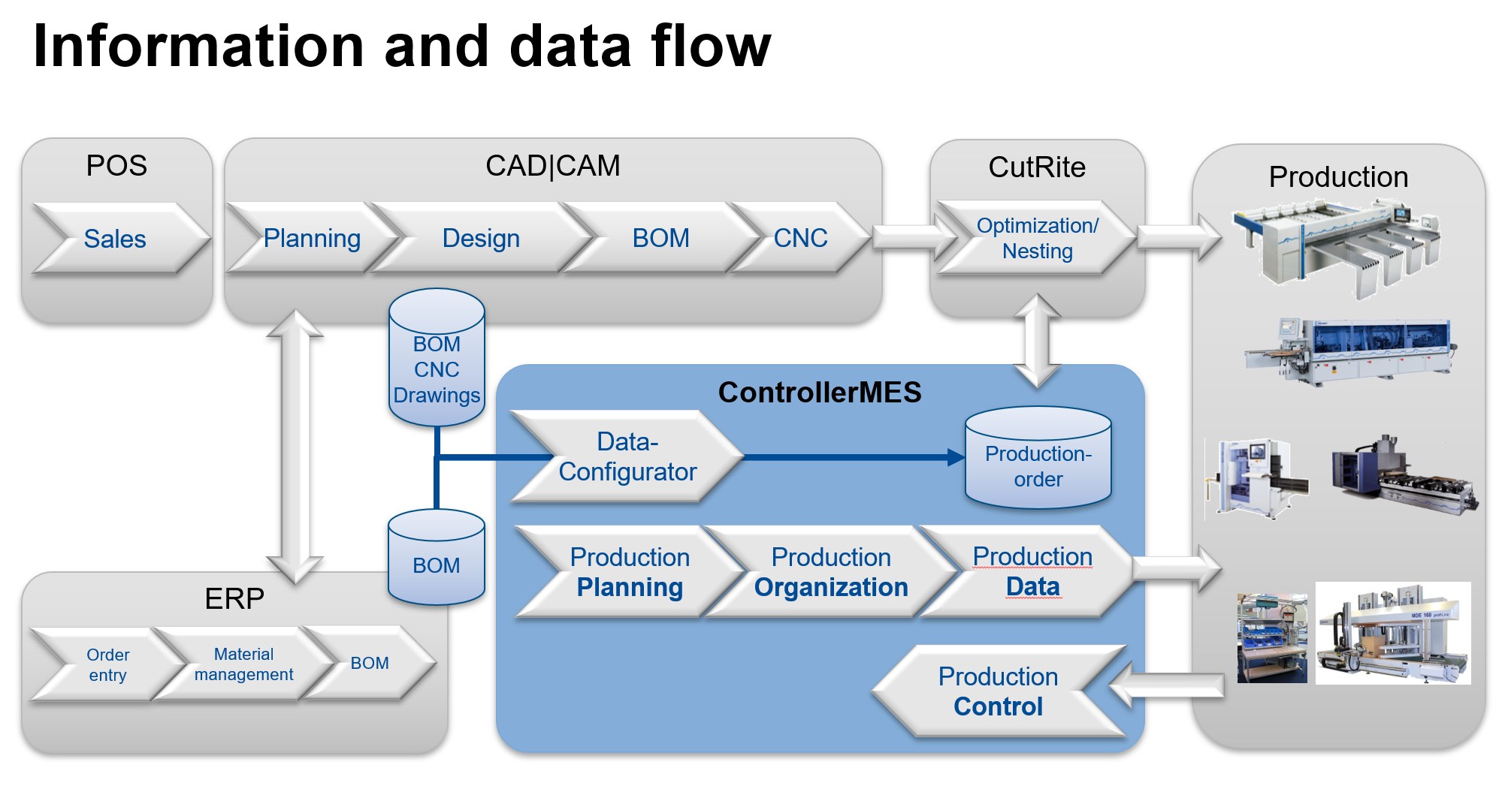

Slide 7
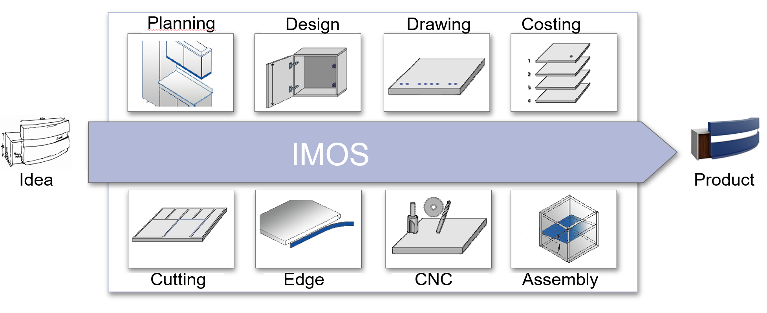
Full integrated CAD-CAM design software

Slide 8
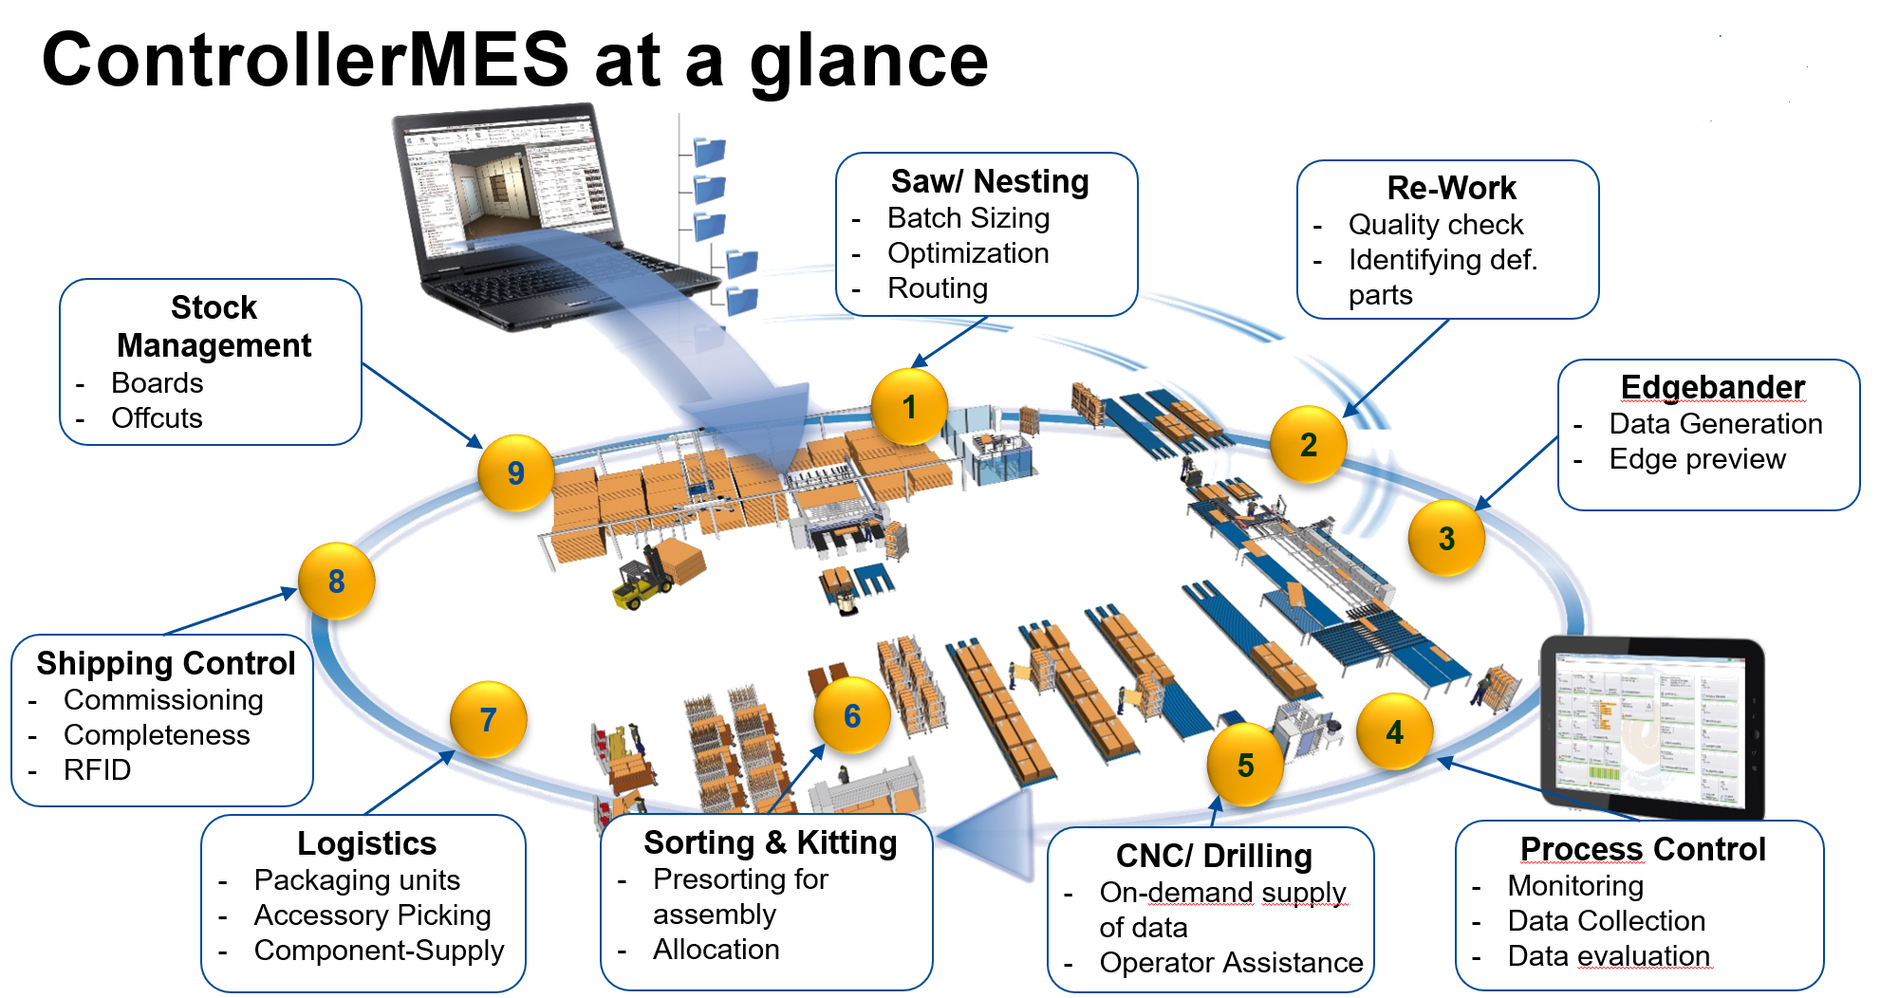

Slide 14
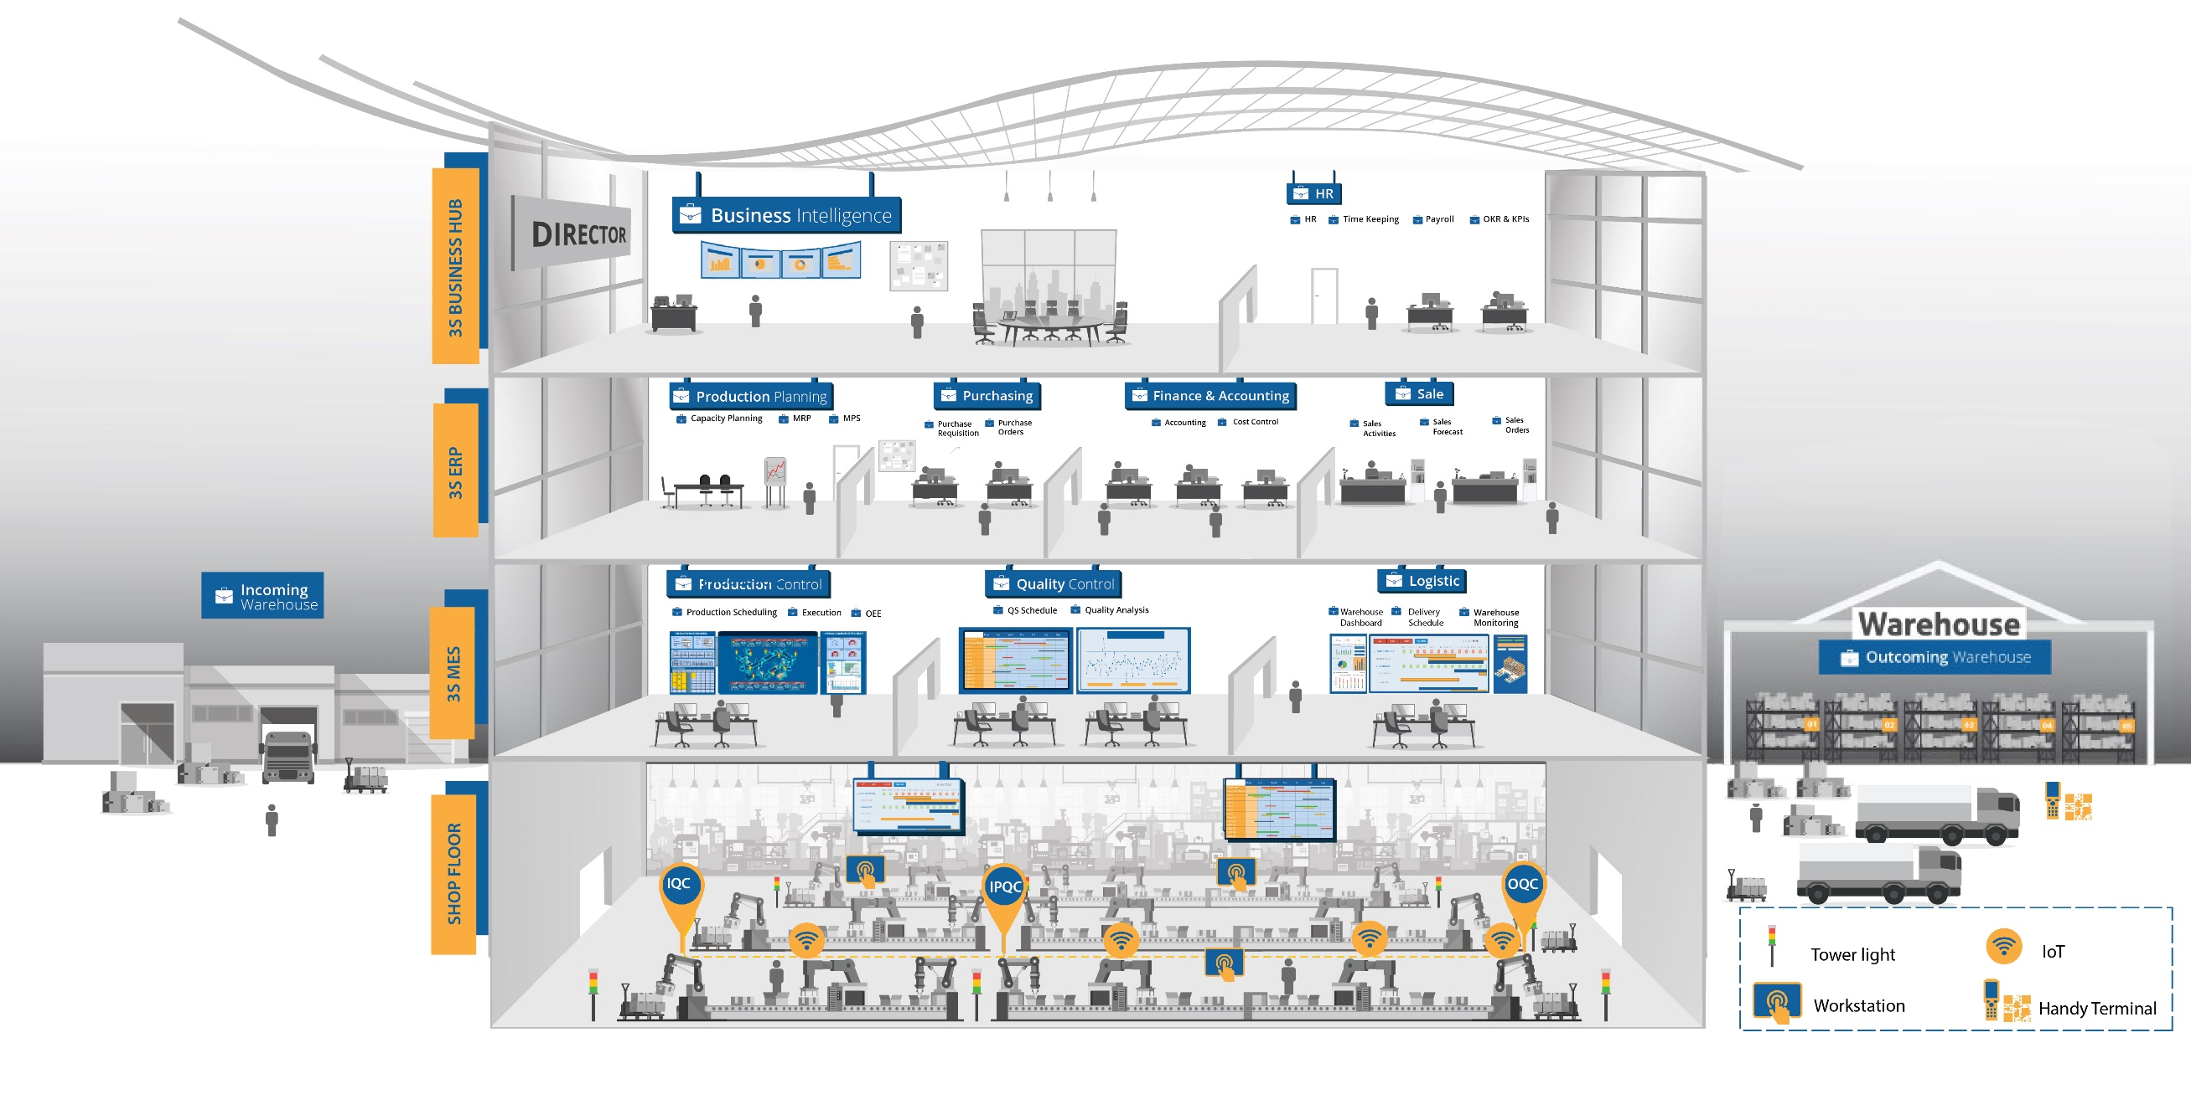
FACTORY VISUALIZATION

